Slide 1

Software Architecture
Scrum

Slide 2
Analysis and Design view model: Relations
Software
Analyses &Design view
are met by
designed with
created with
created for
Architectural patterns
Frameworks
Functional Requirements
include
Persistent data storage

Slide 3
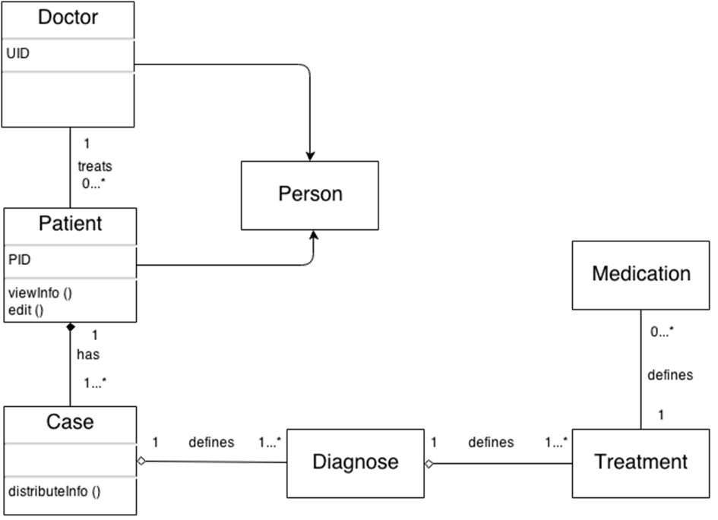
Domain model and Layern Architecture Pattern

Slide 4
Domain model and Layern Architecture Pattern
Webbrowser
Vaadin (User Interface)
we should write a class based on Vaadin Framework
Login
UI Manager
Security Manager
Patient-Data-Manager
Data Import & Export
Vaadin (Binding Data)
Database
methods realised in classes
Access with SQL commands
External Database (Health Institution)
Patient-Info
Patient-Lebenslauf
Timeline

Slide 5
Perspective of the software from the point of view of „Analysis &Design View“ Model
D1:Doctor
D2:Doctor
D3:Doctor
P1:Patient
P2:Patient
P3:Patient
P4:Patient
C1:Case
C2:Case
C3:Case
C4:Case
Di1:Diagnose
Di2:Diagnose
Di3:Diagnose
Di4:Diagnose
Di5:Diagnose
T1:Treatment
T2:Treatment
T3:Treatment
T4:Treatment
M1:Medication
M2:Medication
M3:Medication
UI
Login
Acess
Data
Login
No access

Slide 6


